Slide 1


ABDULRAHMAN_OMAR
Double linked list
Understanding, Implementing, and Utilizing Linked Lists

Slide 2
Agenda
1
what is linked list?.
2
  kinds of linked list
3
  double linked list
Operations on Double Linked Lists
4
5
Code Example

Slide 3



What is linked list?
A linked list is a linear data structure. It consists of a sequence of nodes, where each node contains a piece of data and a pointer to the next node in the sequence.
BACK TO AGENDA PAGE

Slide 4
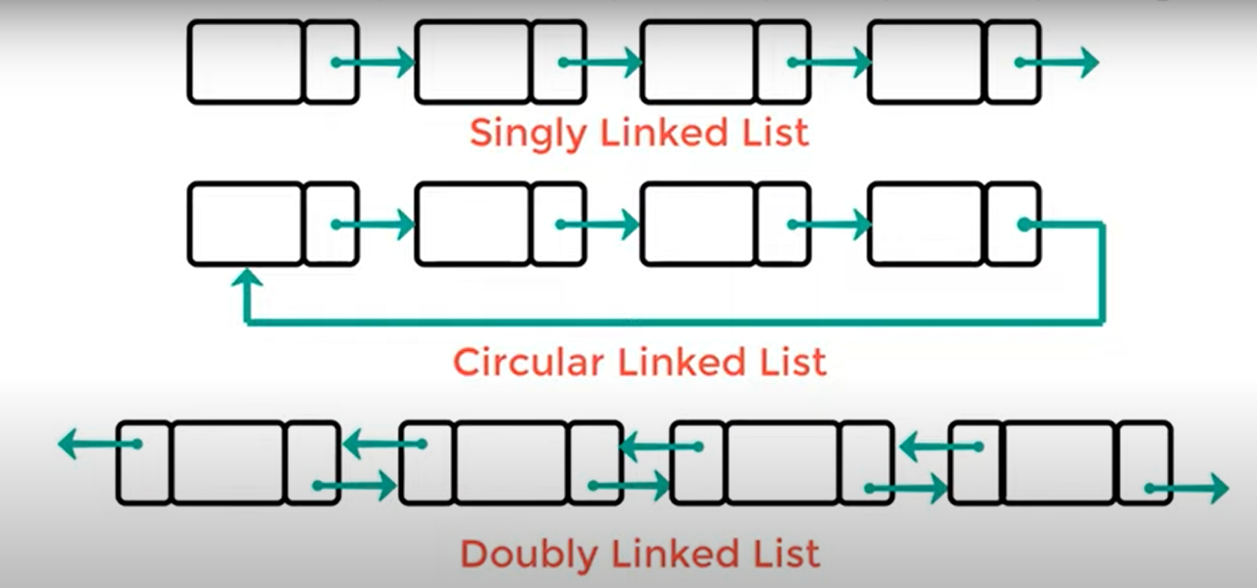


Types of Linked Lists:
  Singly Linked List: Each node points only to the next node in the sequence.
  Doubly Linked List: Each node has pointers to both the next and the previous nodes, enabling bidirectional traversal.
  Circular Linked List: The last node's pointer points back to the first node, forming a circular structure.
LET'S BEGIN!
BACK TO AGENDA PAGE

Slide 5
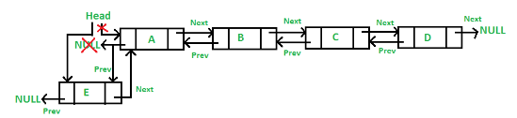
double linked list
A double linked list is a type of linked list where each node contains not only a reference to the next node in the sequence (as in a singly linked list) but also a reference to the previous node.

Slide 6
Operations :
  Insertion: Adding a node at the beginning, end, or in the middle.
  Deletion: Removing a node from the list.
  Traversal: Moving through the list in both forward and backward directions.
  Search: Finding a specific element/node within the list.

Slide 7
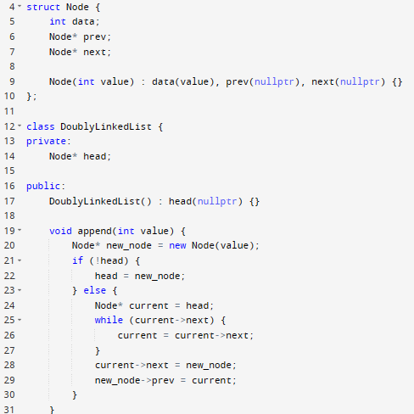
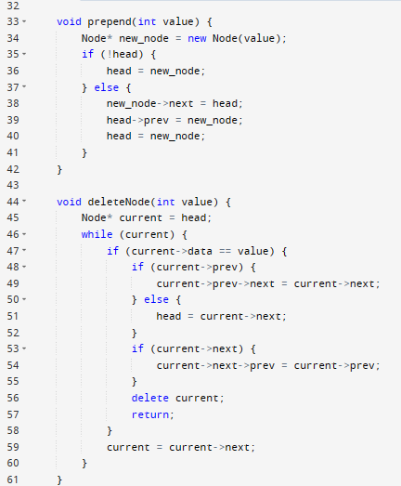
CODE EXAMPLE :

